Slide 1


TACTICAL COMBAT CASUALTY CARE COURSE
Module 22: Cardiopulmonary Resuscitation in Tactical Field Care
MODULE 22: Cardiopulmonary Resuscitation in Tactical Field Care
TCCC TIER 1
All Service Members
TCCC TIER 2
Combat Lifesaver
TCCC TIER 3
Combat Medic/Corpsman
TCCC TIER 4
Combat Paramedic/Provider

Slide 2




Module 22: Cardiopulmonary Resuscitation in Tactical Field Care
TACTICAL COMBAT CASUALTY CARE (TCCC) ROLE-BASED TRAINING SPECTRUM
ROLE 1 CARE
NONMEDICAL PERSONNEL
MEDICAL PERSONNEL
YOU ARE HERE
STANDARDIZED JOINT CURRICULUM

Slide 3






Module 22: Cardiopulmonary Resuscitation in Tactical Field Care
1 x TERMINAL LEARNING OBJECTIVES
25
Describe cardiopulmonary resuscitation (CPR) in Tactical Field Care.
  Identify the conditions of and considerations for cardiopulmonary resuscitation in Tactical Field Care.
  Demonstrate bilateral Needle Decompression of the Chest in Tactical Field Care .
2 x ENABLING LEARNING OBJECTIVES
#
= Terminal Learning Objectives
= Cognitive ELOs
= Performance ELOs

Slide 4
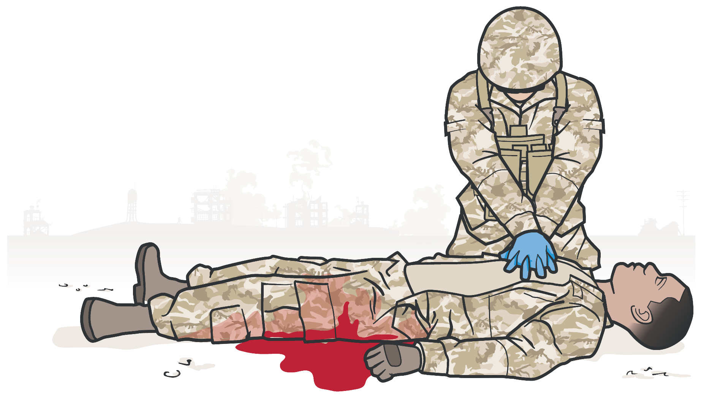
Module 22: Cardiopulmonary Resuscitation in Tactical Field Care
CARDIOPULMONARY RESUSCITATION IN THE PREHOSPITAL SETTING
BATTLEFIELD CONSIDERATIONS:
Delays in getting casualty to definitive care
138 trauma patients with prehospital cardiac arrest where resuscitation was attempted - No survivors
Recommendation: CPR not be attempted for patients with prehospital traumatic cardiac arrest (large economic costs and uniformly unsuccessful results)
Responder risk performing CPR in hostile environment
Taking limited resources away from other casualties while performing CPR
Rosemurgy et al. J Trauma 1993
Resuscitation on the battlefield for victims of blast or penetrating trauma who have no pulse, no ventilations, and no other signs of life will not be successful and should not be attempted.
TCCC Guidelines (5 Nov 2020)

Slide 5
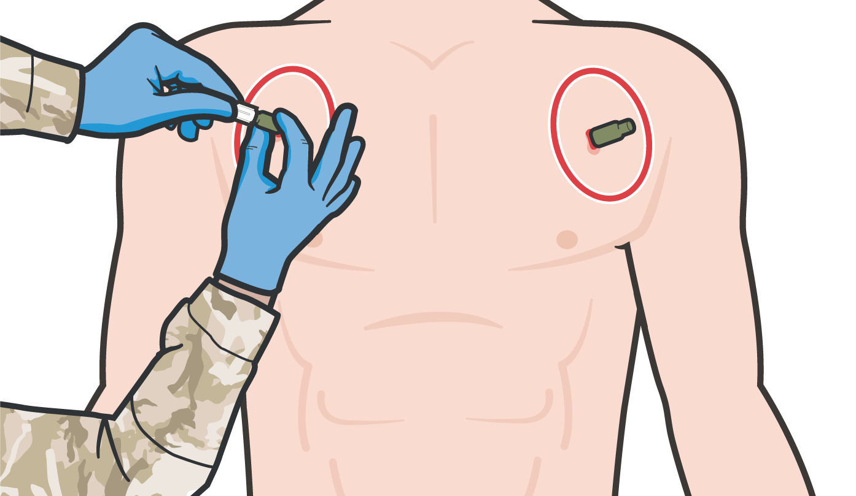
NON-HYPOVOLEMIC CARDIAC ARREST IN A TRAUMA CASUALTY
Module 22: Cardiopulmonary Resuscitation in Tactical Field Care
Tension pneumothorax can cause cardiac arrest in trauma casualties
Retrospective civilian prehospital studies indicate needle decompression of the chest (NDC) restored cardiac output
Anecdotal military cases report return of pulses with NDC
Armed Forces Medical Examiner data: pneumothoraces may have played a role in fatalities from recent conflicts
Perform bilateral NDC in casualties with no
pulses or respirations in Tactical Field Care
…casualties with torso trauma or polytrauma who have no pulse or respirations during TFC should have bilateral needle decompression performed to ensure they do not have a tension pneumothorax prior to discontinuation of care.
TCCC Guidelines (5 Nov 2020)

Slide 6
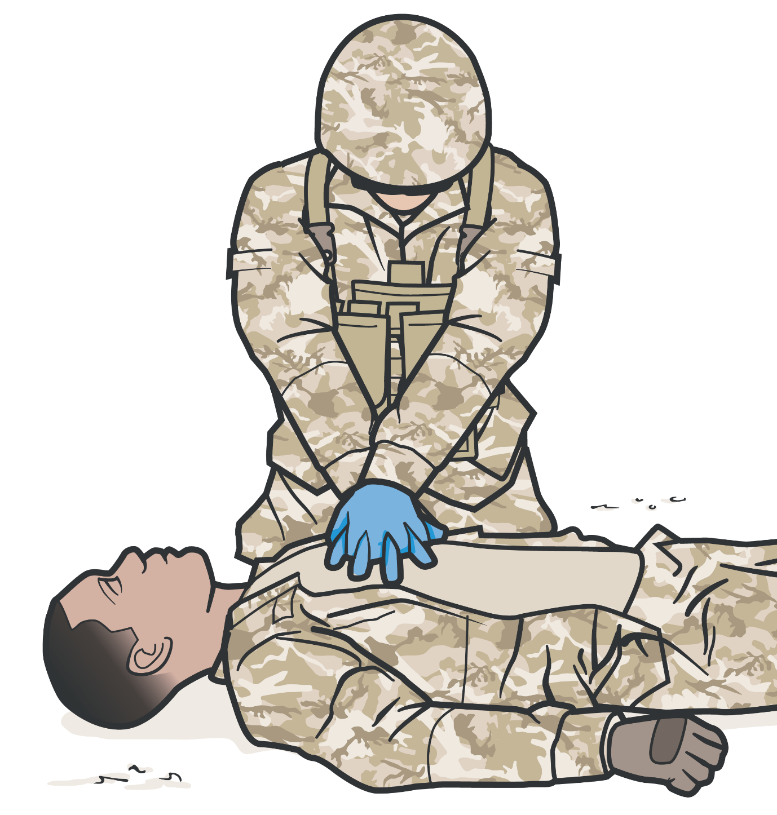

Module 22: Cardiopulmonary Resuscitation in Tactical Field Care
CONSIDERATIONS FOR CARDIOPULMONARY RESUSCITATION
Cardiac arrest in the absence of blast or penetrating trauma may warrant consideration for initiation of CPR:
REMINDER: Disadvantages to CPR in TFC:
Responder risk in hostile environment
Taking limited resources away from other casualties
Hypothermia Near drowning Electrocution
Non-traumatic cardiac arrest In Tactical Evacuation Phase
(if casualty does not have obviously fatal wounds and will arrive at a surgical facility soon)
CPR should not be done at the expense of compromising the mission or denying lifesaving care to other casualties

Slide 7

BILATERAL NEEDLE DECOMPRESSION

Slide 8



Module 22: Cardiopulmonary Resuscitation in Tactical Field Care
CARDIOPULMONARY RESUSCITATION IN TACTICAL FIELD CARE
Bilateral Needle Decompression of the Chest

Slide 9
SUMMARY
Module 22: Cardiopulmonary Resuscitation in Tactical Field Care
No CPR for casualties with blast or penetrating trauma and no signs of life (pulses or respirations)
Bilateral needle decompressions for casualties with no pulses or respirations
Consider CPR in non-traumatic cardiac arrest if it won’t compromise the mission or put others at risk

Slide 10

CHECK ON LEARNING
Module 22: Cardiopulmonary Resuscitation in Tactical Field Care
Should you initiate CPR for a casualty with blast or penetrating trauma who has no pulse, respirations or signs of life?
When should you perform a bilateral needle decompression of the chest?
In what circumstance might you consider CPR in the Tactical Field Care phase?

Slide 11



Module 22: Cardiopulmonary Resuscitation in Tactical Field Care
ANY QUESTIONS?

Slide 12

REFERENCES
Module 22: Cardiopulmonary Resuscitation in Tactical Field Care
TCCC: Guidelines
by JTS/CoTCCC
Updated regularly – latest edition dated 5 November 2020
These guidelines are the result of decisions made by the Committee on Tactical Combat Casualty Care as they explore evidence-based research regarding best practices
PHTLS: Military Edition, Chapter 25
by NAEMT
Prehospital Trauma Life Support, Military Ninth Edition
NOV 2020

